Slide 1

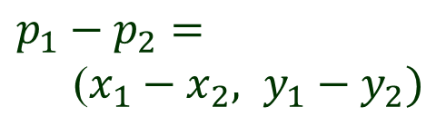
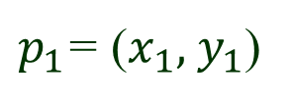
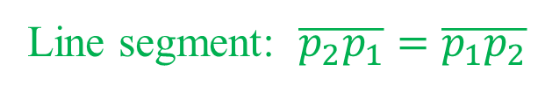
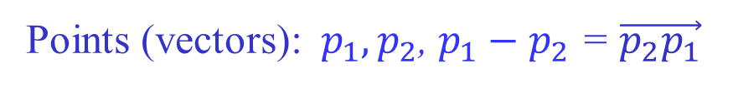

Line Segments & Vectors
y
$p_{1}$= ($x_{1}, { y}_{1}$)
$p_{1}−p_{2}$ $=$
($x_{1}−x_{2}, y_{1}−y_{2})$
$$p_{2}= (x_{2} , y_{2})$$
$$O = (0, 0)$$
x
Points (vectors):${ p}_{1}, p_{2}$, $p_{1}−p_{2}$ = $\vec{p_{2}p_{1}}$
Line segment: $\overline{p_{2}p_{1}}=\overline{p_{1}p_{2}}$

Slide 2
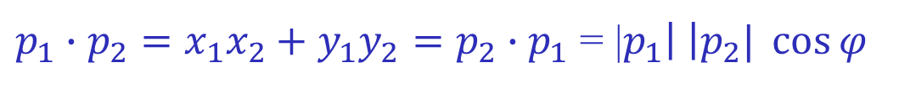






Dot (Inner) Product
$$y$$
$$p_{2}$$
$$φ$$
$$p_{1}$$
$(0, 0)$
$$x$$
$p_{1}∙p_{2}=x_{1}x_{2}+y_{1}y_{2}=p_{2}∙p_{1}$ = |$p_{1}\left| \right|p_{2}| \cos{φ}$

Slide 3
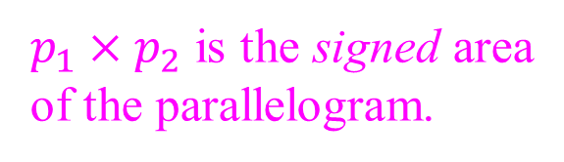




Cross (Vector) Product
$$y$$
$$p_{1}+p_{2}$$
$$p_{2}$$
$p_{1}×p_{2}$ is the signed area
of the parallelogram.
$$φ$$
$$p_{1}$$
$$(0, 0)$$
$$x$$
$p_{1}×p_{2}=x_{1}y_{2}−x_{2}y_{1}=−p_{2}×p_{1}=$|$p_{1}\left| \right|p_{2}| \sin{φ}$
$p_{1}$ and $p_{2}$ are collinear with the origin iff $p_{1}×p_{2}=$ $0$.

Slide 4












Turning of Consecutive Segments
Segments $\overline{p_{0}p_{1}}$ and $\overline{p_{1}p_{2}}$. Move from $p_{0}$ to $p_{1}$ then to $p_{2}$.
$$p_{2}$$
$$p_{2}$$
$$p_{1}$$
$$p_{2}$$
$$p_{1}$$
$$p_{1}$$
$$p_{0}$$
$$p_{0}$$
$$p_{0}$$
Counterclockwise Clockwise Turn of 0 or $π$
$$\vec{p_{0}p_{1}}×\vec{p_{1}p_{2}}>0$$
$\vec{p_{0}p_{1}}×\vec{p_{1}p_{2}}$ $< 0$
$$\vec{p_{0}p_{1}}×\vec{p_{1}p_{2}}= 0$$

Slide 5





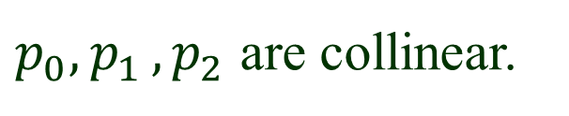




Collinear Points
$$\vec{p_{0}p_{1}}×\vec{p_{1}p_{2}}= 0$$
$p_{0}{, p}_{1}{, p}_{2}$ are collinear.
$$p_{2}$$
$$p_{1}$$
$$p_{1}$$
$$p_{2}$$
$$p_{0}$$
$$p_{0}$$
No change of direction Direction reversal
$$\vec{p_{0}p_{1}}∙\vec{p_{1}p_{2}}>0$$
$\vec{p_{0}p_{1}}∙\vec{p_{1}p_{2}}$ $< 0$

Slide 6




Polar Angle
$$y$$
$$q$$
polar angle
p
$$x$$
$$r$$

Slide 7

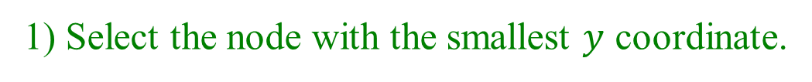
Sorting by Polar Angle
1) Select the node with the smallest $y$ coordinate.
$$p_{0}$$

Slide 8

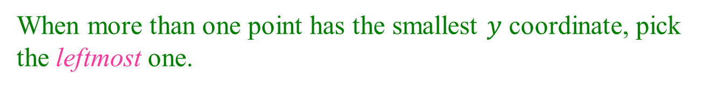
Tie Breaking (1)
When more than one point has the smallest $y$ coordinate, pick
the leftmost one.
$$p_{0}$$

Slide 9




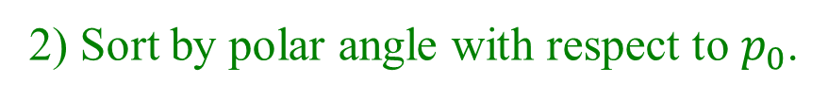







Sorting Outcome
2) Sort by polar angle with respect to $p_{0}$.
$$p_{9}$$
$$p_{6}$$
$$p_{4}$$
$$p_{11}$$
$$p_{7}$$
$$p_{3}$$
$$p_{8}$$
$$p_{10}$$
$$p_{5}$$
$$p_{2}$$
$$p_{1}$$
$$p_{0}$$
$$p_{0}$$
Labels are in the polar angle order.

Slide 10

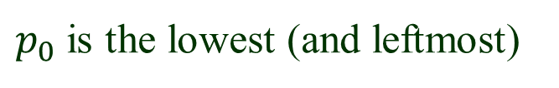




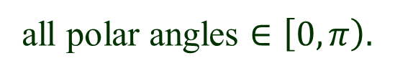

No Polar Angle Evaluation
$p_{0}$ is the lowest (and leftmost)
all polar angles $∈\left[0, π\right).$
$Use cross product!$
$$p_{i}< p_{j}$$
if
$$\vec{p_{0}p_{i}} ×\vec{p_{0}p_{j}}>0$$
$$p_{i}$$
$$p_{j}$$
$$p_{0}$$

Slide 11




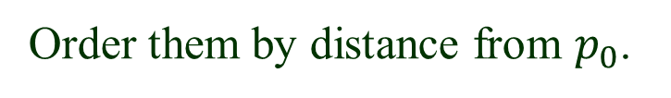
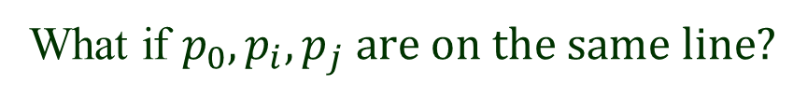



Tie Breaking (2)
What if ${p_{0}, p}_{i}, p_{j} are on the same line?$
Order them by distance from $p_{0}$.
$$p_{i}< p_{j}$$
if and
$$\vec{p_{0}p_{i}} ×\vec{p_{0}p_{j}}=0$$
$$\left|\vec{p_{0}p_{i}}\right|<|\vec{p_{0}p_{j}}|$$
$$p_{j}$$
No square roots.
Use dot product!
$$p_{i}$$
$$p_{0}$$
$$\vec{p_{0}p_{i}}∙\vec{p_{0}p_{i}}<\vec{p_{0}p_{j}}∙\vec{p_{0}p_{j}}$$

Slide 12
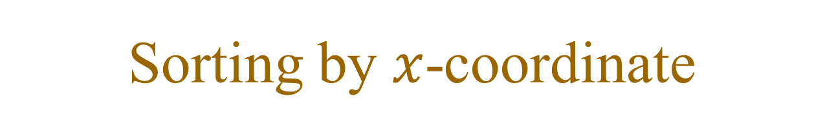
Sorting by $x$-coordinate
Imagine a vertical line sweeping across the plane from left to right.
It hits the endpoints of these line segments one by one.
Sweep
line

Slide 13





Tie Breaking (3)
What if $two or endpoints are on the same vertical line?$
Order them by $y$-coordinate.
$$p_{2}$$
$$p_{3}<p_{1}<p_{2}$$
$$p_{1}$$
$$p_{3}$$

